Slide 1

Comprehensive Analysis of NFL Player Performance and Game Strategies
Dipak Bhattarai
Hussain Manasi
Crystal Pendergrass

Slide 2
Project Overview
Objective:
Conduct a comprehensive analysis of NFL player performance and game strategies using data from the NFL Big Data Bowl 2024
Approach:
In-Depth Analysis: Unraveling insights into player performance and game dynamics
Meaningful Visualizations: Translating raw data into impactful visuals for enhanced understanding
Dynamic Animations: Bringing plays to life, replicating the strategic dance of offensive

Slide 3
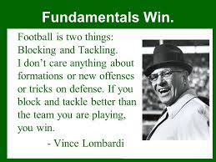
Data Source
Source:
NFL Big Data Bowl 2024 data from Kaggle (https://www.kaggle.com/competitions/nfl-big-data-bowl-2024)
Data Summary:
Game data: teams playing in each game
Play data: play-level information from each game
Player data: player-level information
Tackles data: player-level tackle information for each game and play
Tracking data: player tracking data from week number

Slide 4
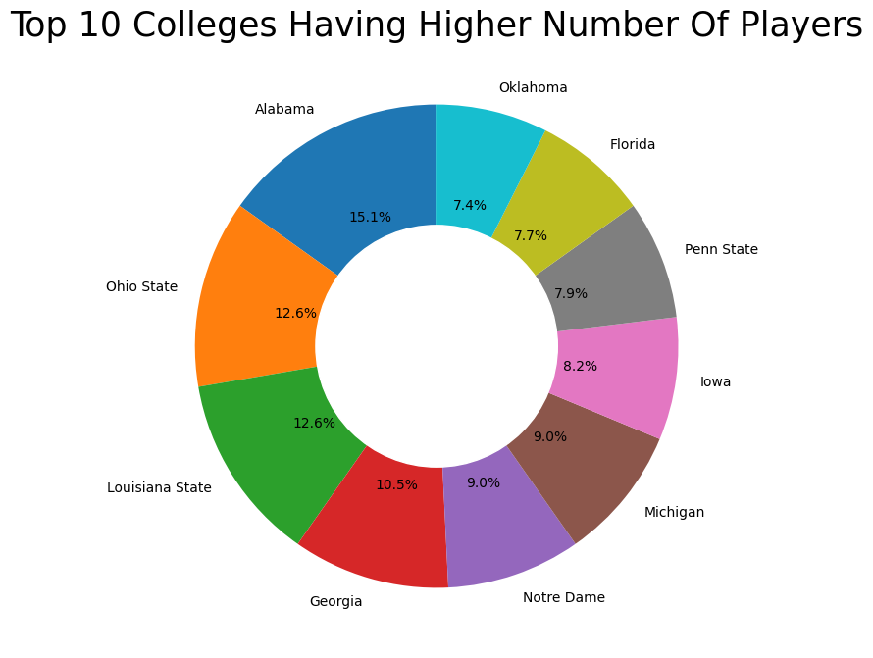
Data Analysis
Number of players

Slide 5
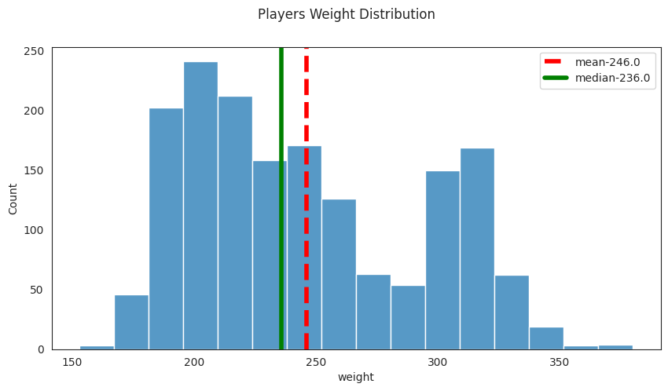
Data Analysis (Cont.)

Slide 6
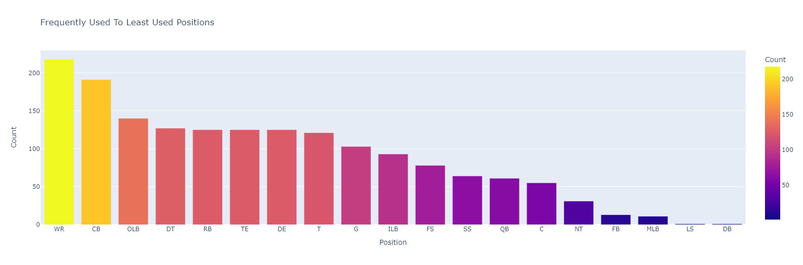
Exploratory Data Analysis
Frequently Used To Least Used Positions

Slide 7
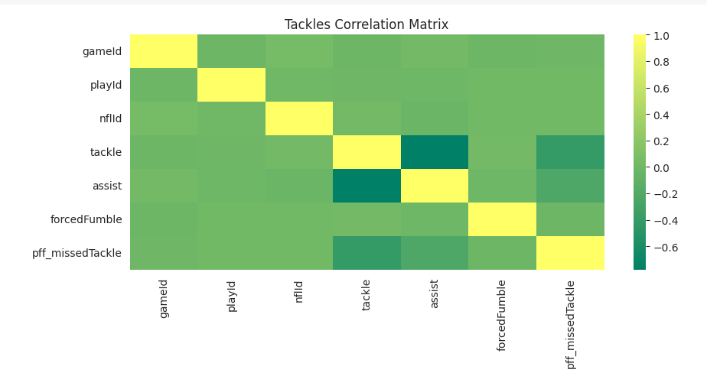
Exploratory Data Analysis
Feature Correlation to Tackle

Slide 8
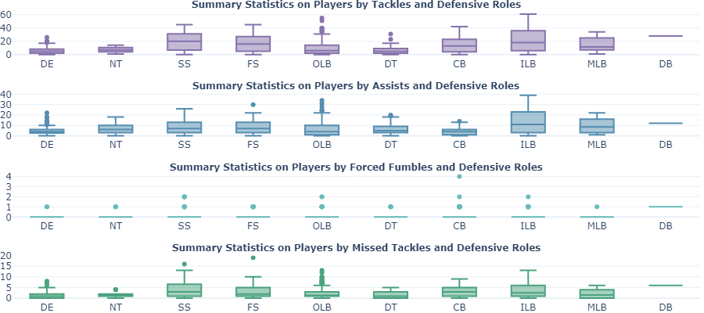
Exploratory Data Analysis
Distribution of Tackles by Players

Slide 9
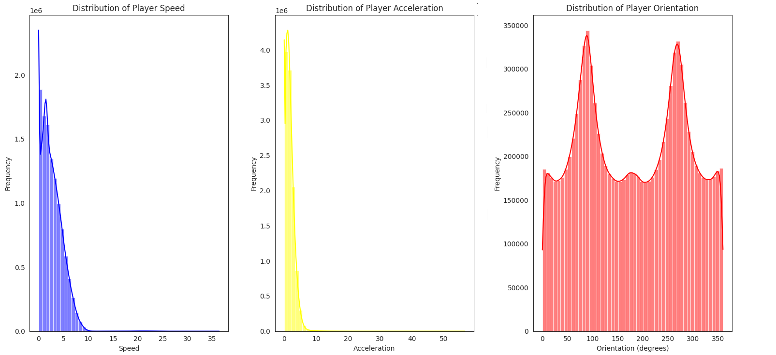
Analysis Process
Player Performance Metrics

Slide 10
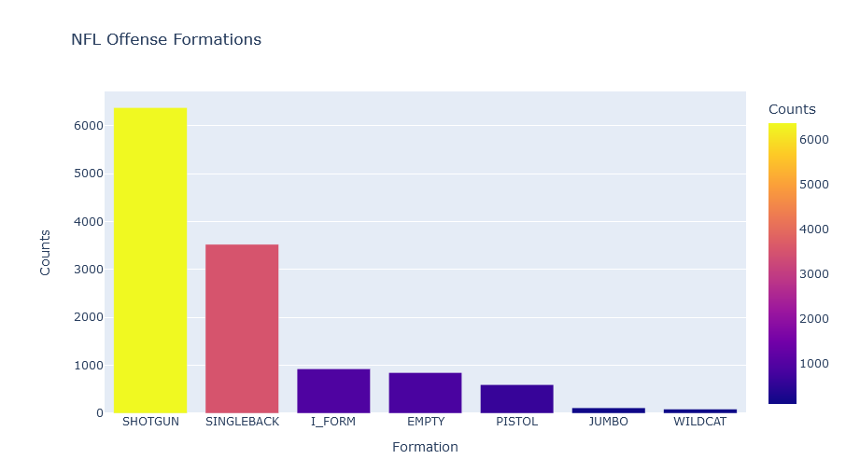
Analysis Process
The most common plays used by offense

Slide 11
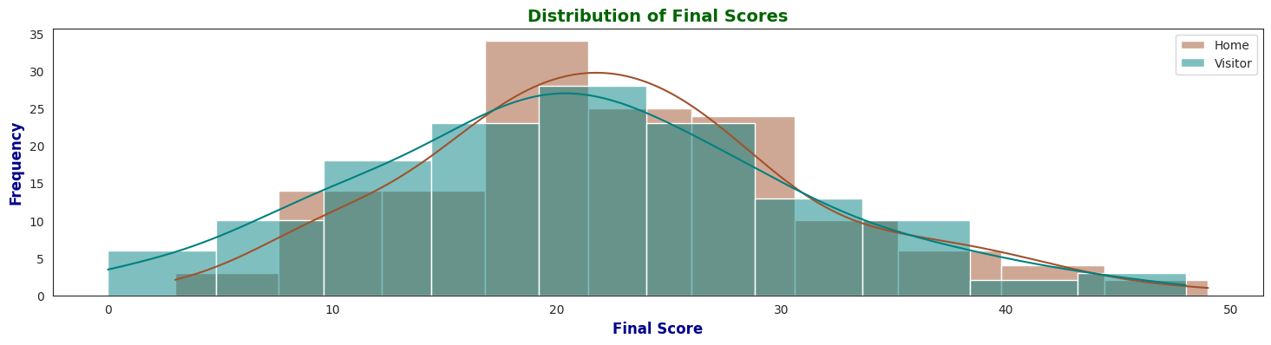
Analysis Process
Overall comparison of final scores for home and visiting teams

Slide 12
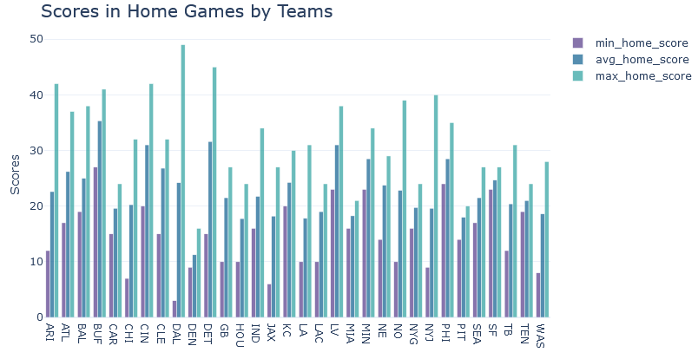
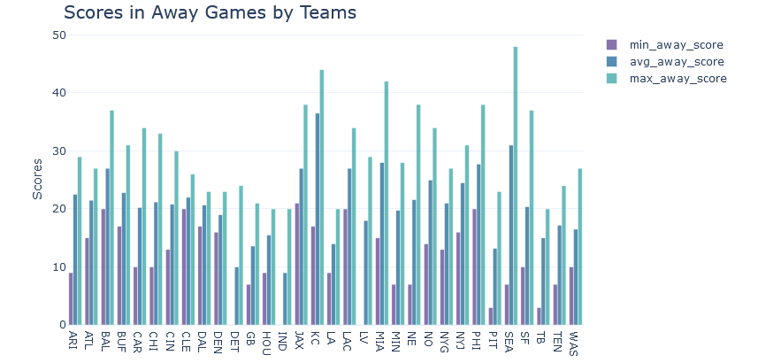
Analysis Process
Win Probability Dynamics

Slide 13
Visualizing Players on Field

Slide 14
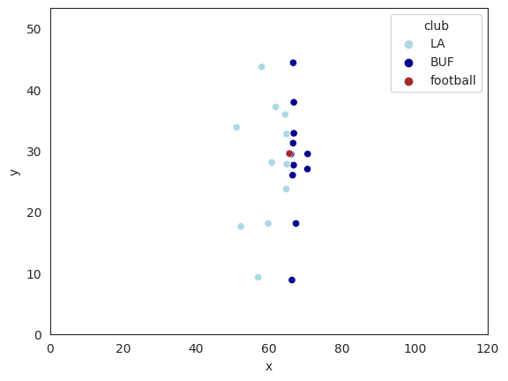
Visualizations
Tracking the position of players throughout a play

Slide 15
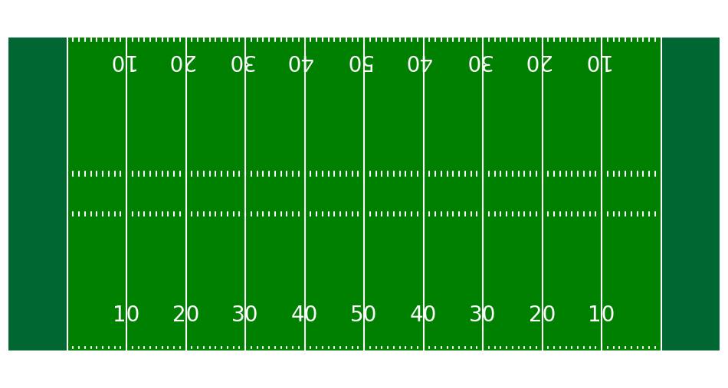
Visualizations
Tracking the position of players throughout a play

Slide 16
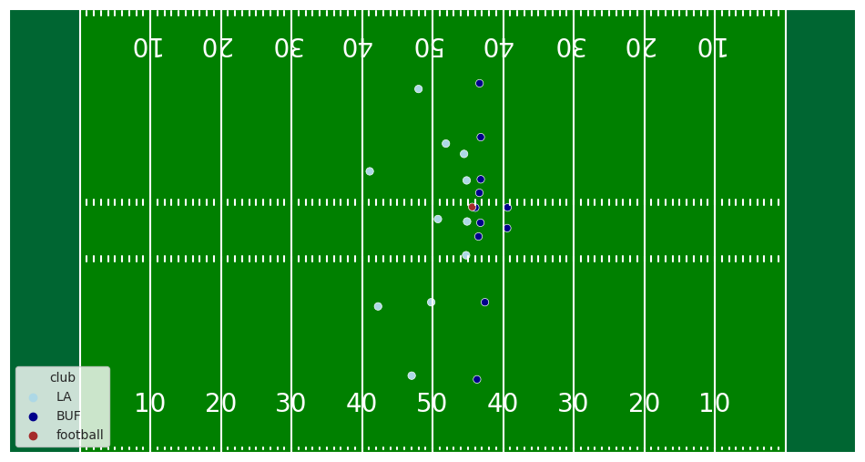
Visualizations
Tracking the position of players throughout a play

Slide 17
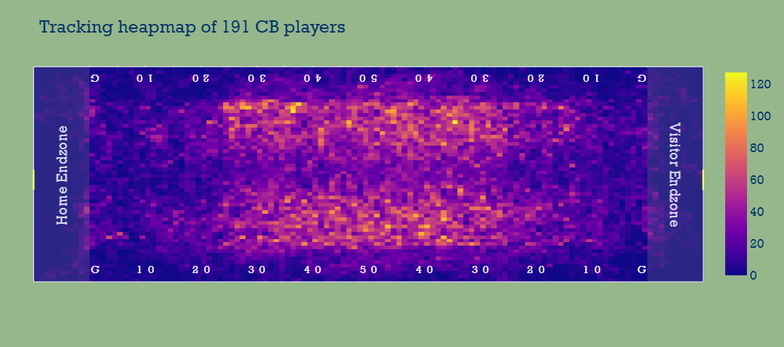
Visualizations
Tracking the position of players throughout a play

Slide 18
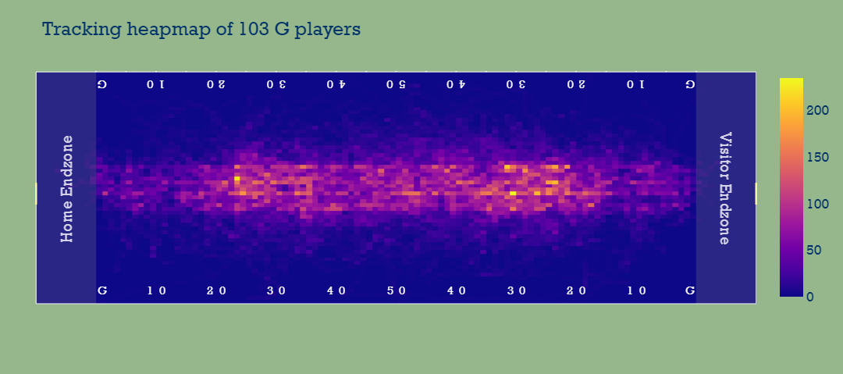
Visualizations
Trends in the range of motion per position

Slide 19
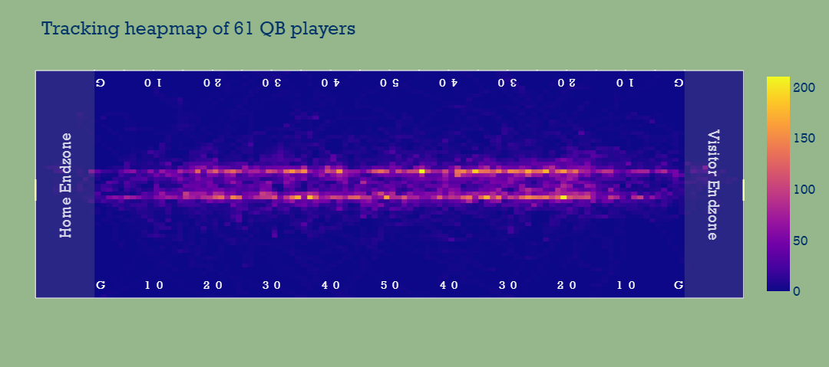
Visualizations
Trends in the range of motion per position

Slide 20
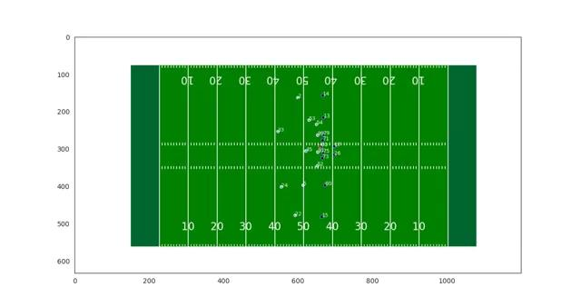
Animation: Player direction of motion

Slide 21
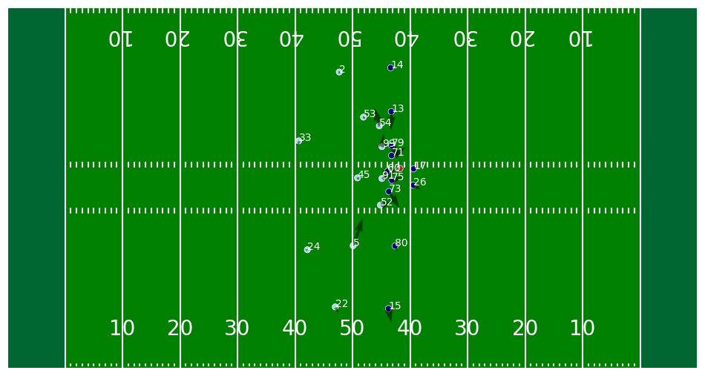
Focus: Player direction of motion

Slide 22
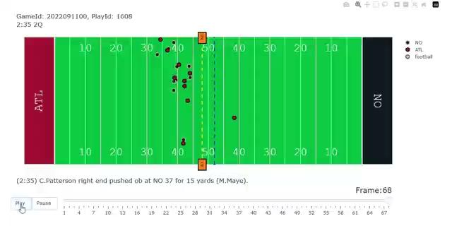
Animation: An actual play between teams

Slide 23
Questions?
Thank you for listening.

